Slide 1

Korea: brief history and Culture
Lucy Park
Executive Director, Sejong Cultural Society

Slide 2
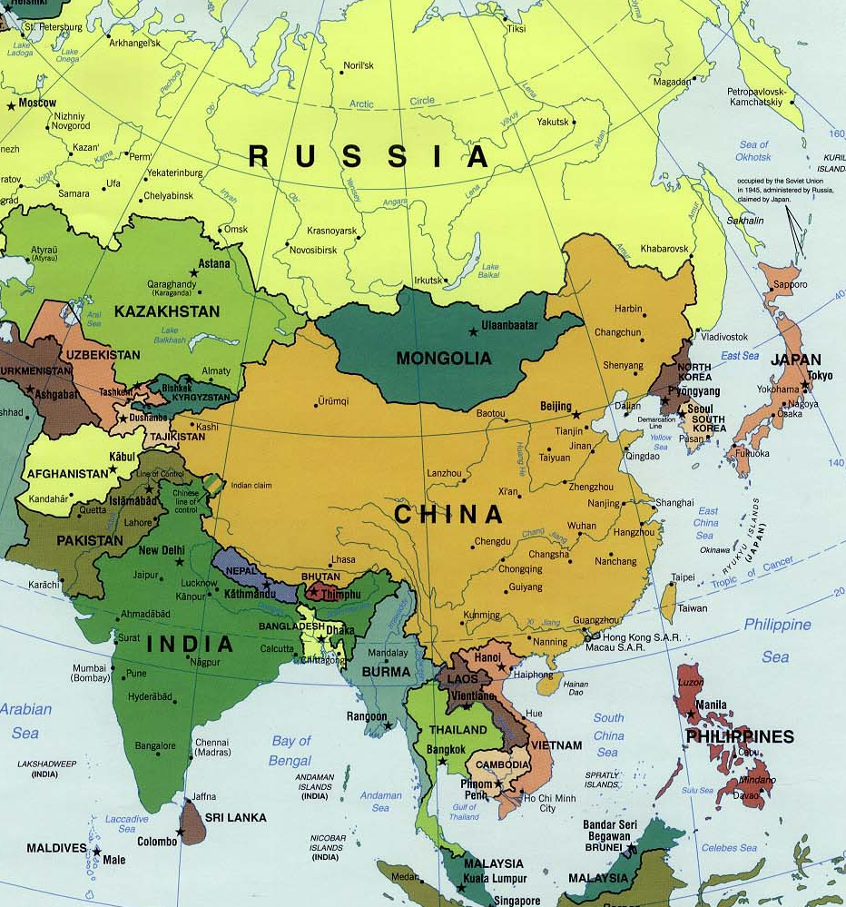
KOREA
Located between China and Japan
Continuous cultural and geopolitcal interactions with China and Japan
Korean language is considered “language isolate”
Notes:
Korea is a peninsula located between China and Japan. Some consider the Korean language as one a “language isolate”, a natural language with no demonstrable genealogical relationship with other languages; others note possible links to Altaic, or Japanese.

Slide 3
Country Area & Population
 | Area (km²) | Population (million) | GDP* (trillion)
South Korea | 99k | 51 | 1.5
North Korea | 120k | 25 | _
Japan | 377k | 126 | 4.8
China | 9,596k | 1,400 | 12.2
USA | 9,833k | 326 | 19.3
The World Factbook: US Central intelligence Agency (2017)
*World Bank (2017)
Notes:
GDP per capita, ranking (out of 230)
Qatar #1 ($129,700),
USA #18,
Japan #41,
South Korea #45,
China #104,
North Korea #211,
Somalia #230 ($400 )

Slide 4
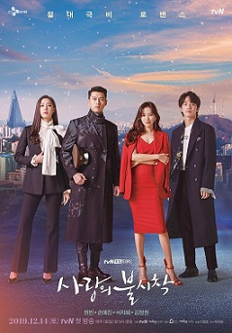

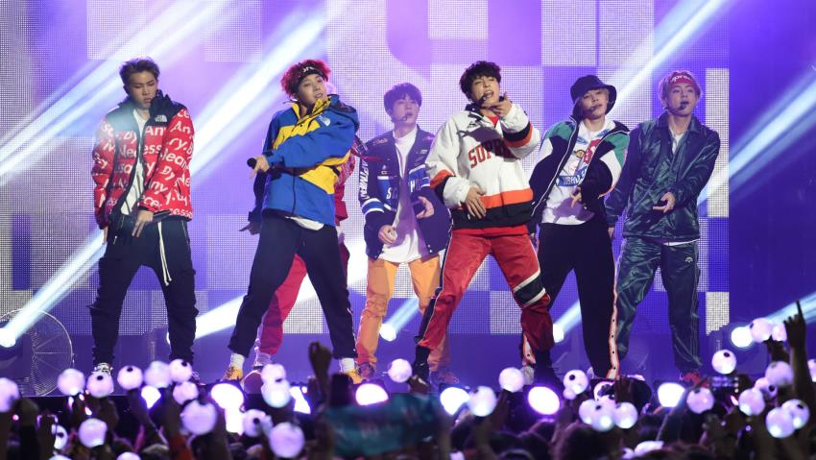
Korean Wave (Hallyu):
Korean Cultural Export since early 1990s
Korean movies, TV dramas, and pop-music are very popular around the world; rapidly spreading beyond Asian countries
Korea is among the world’s top ten cultural exporters
Parasite
Crash Landing on You
BTK (Bang Tan Sonyun dan)
Notes:
Click the pictures to watch music videos and excerpts from TV dramas.
The Korean Wave (Hallyu, 한류, 韓流) refers to the increased popularity of South Korean culture around the world since 1990s. The term was coined in China in mid-1999 by Beijing journalists surprised by the fast growing popularity of South Koreans and South Korean goods in China. South Korea is among the world's top ten cultural exporters and the Korean wave began with the export of Korean TV dramas such as “Autumn Fairy Tale”, “Winter Sonata”, “Dae Jang Geum” (Jewel in the Palace), and “Princess Hours” across East and Southeast Asia. The growing success of Korean dramas was soon matched by Korean movies, popular music, food and language. While popular throughout Asia, the Korean Wave's influence is most visible in China, Japan and Southeast Asia, spreading to the Middle East and Russia.
The Korean Wave is rapidly expanding beyond Asia through the internet and has a substantial presence in North, Central and South America, and is increasingly becoming popular in the United States and Canada. It is gathering positive interest in North Africa. Currently, the Korean wave is starting to hit Europe (including United Kingdom, France, Spain, Germany), New Zealand, and Australia.
Korean Movie “Oldboy” won Grand Prix at the 2004 Cannes Film Festival and high praise from Quentin Tarantiono, who was the president of the jury. The film has been well received in the US with high rating at Rotten Tomatoes and Roger Ebert. In 2008 voters on CNN named It one of the ten best Asian films eve made.

Slide 5
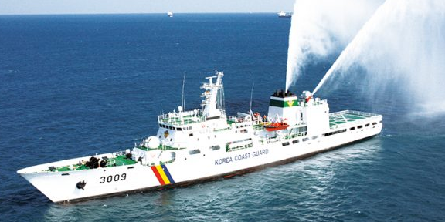








Modern Korea
One of the world’s fastest growing economies
World’s 5th largest exporter
Notes:
South Korea is a developed country and has had one of the world's fastest growing economies from the early 1960s. Korean GDP ranked No. 12 in the world. As of 2009, South Korea is the world's eighth largest exporter.
Well known Korean brands include Samsung, Hyundai, LG, and Kia motors.

Slide 6
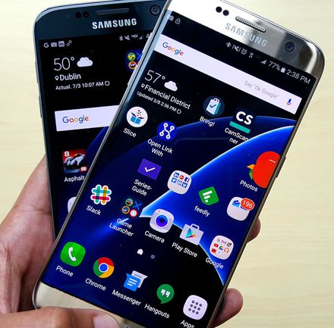

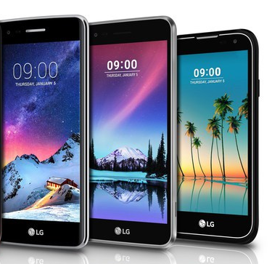
Mobile Phones Global Market Share
  Samsung 23.5%
  Apple 15.9%
  Huawei 12.1%
  LG 3%
(Counterpoint: 2018 Q1)

Slide 7
Internet and WiFi Connectivity
The first country to complete the conversion from dial-up to broadband by 2005.
The fastest average internet connection in the world in 2017
  South Korea: 28.67 Mbps (#1)
  USA: 18.7 Mbps (#10)
  Global average: 7.2 Mbps
The cheapest
  1 Gbit/s connections or 1,000 Mbit/s at $20 per month in Seoul
https://www.usnews.com/news/best-countries/slideshows/10-countries-with-the-fastest-internet-speeds?onepage

Slide 8
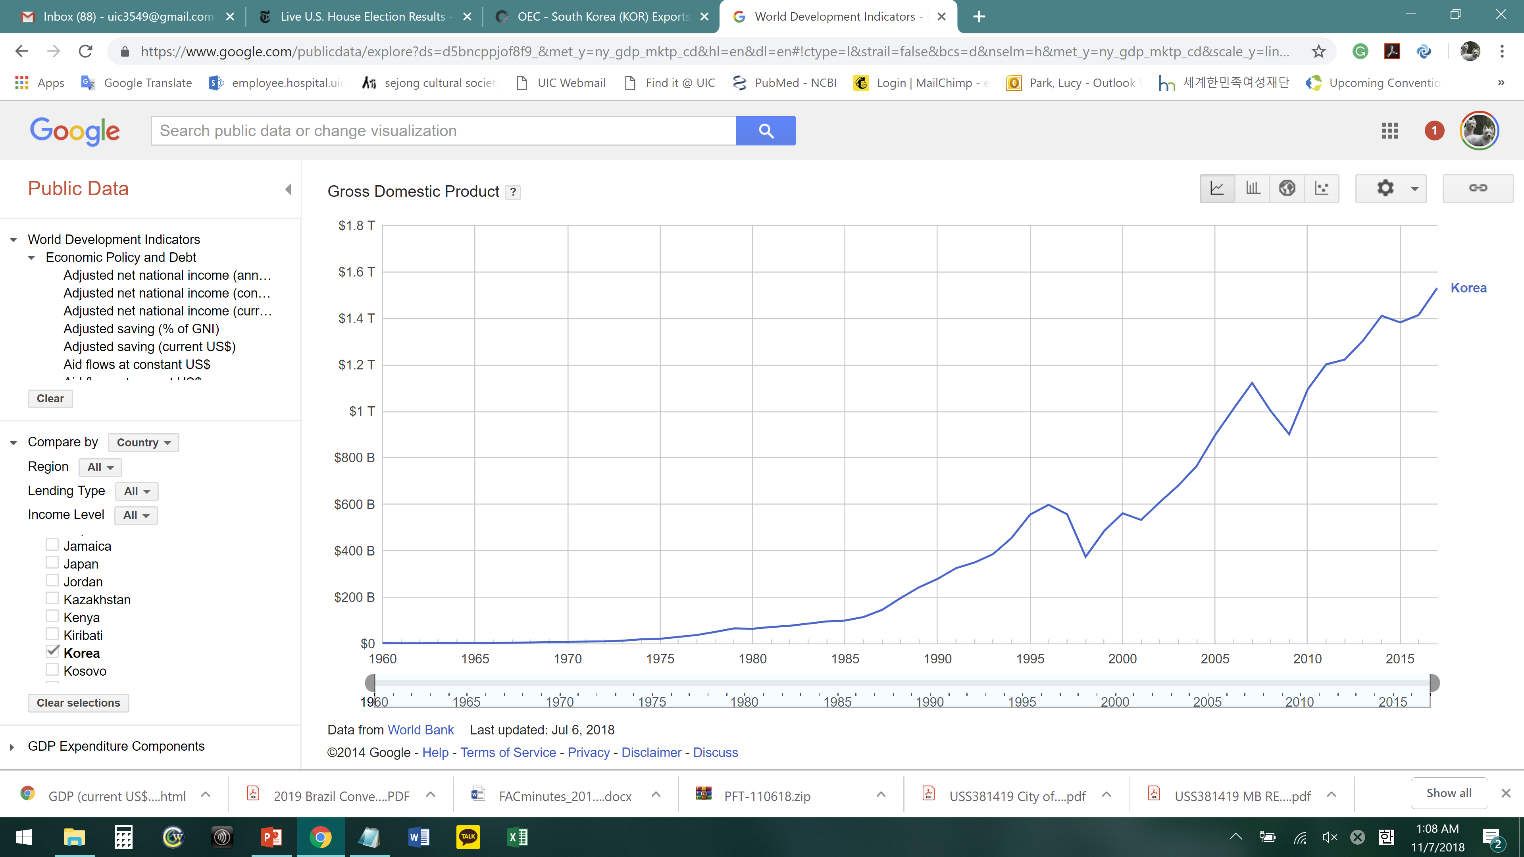
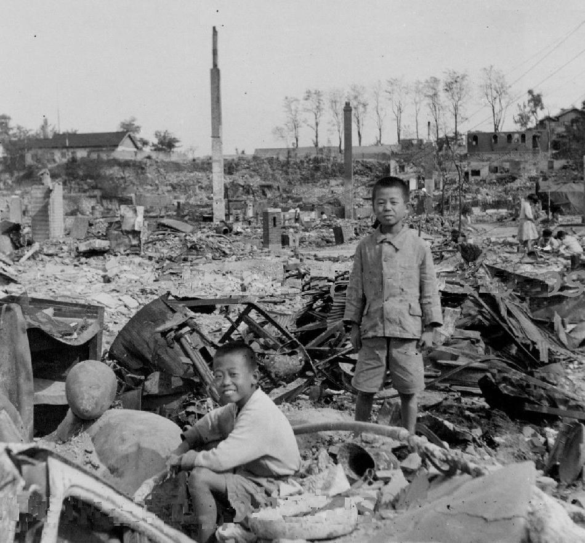
KOREA: Gross Domestic Product 1960- 2018
Economic development plan began after military coup in 1961
Export oriented industry
Technologically advanced
2018 Korean GDP ranked No. 11 in the world.
GDP growth: Data from World Bank 2018
Korea in 1953 at the end of Korean war

Slide 9
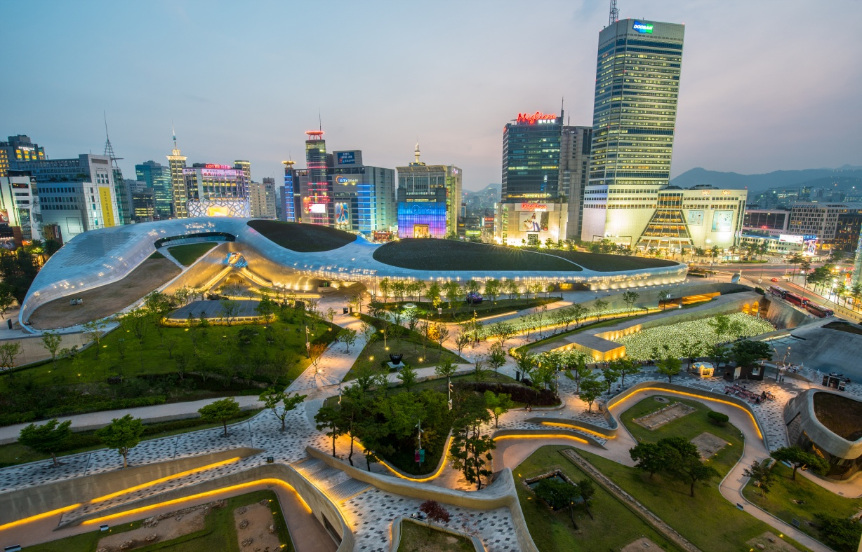
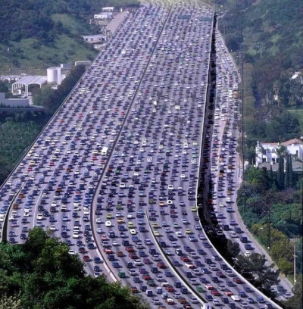
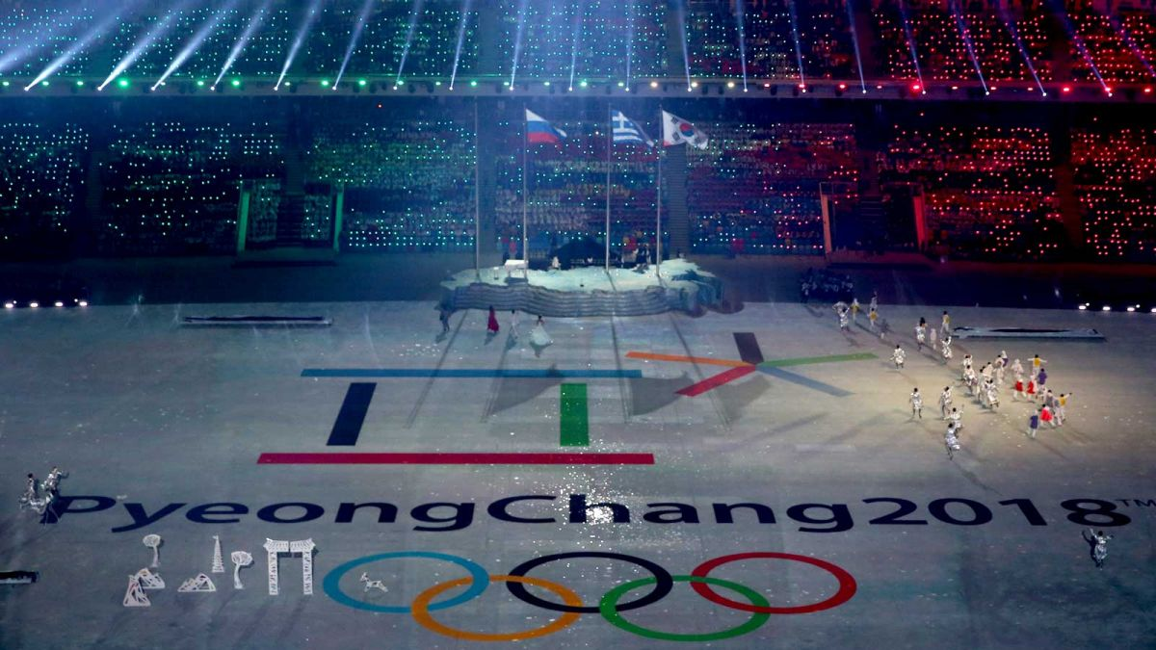
KOREA: now
11th largest economy
Nominal GDP: $1.53 trillion
GDP (PPP): $2.02 trillion
https://www.investopedia.com/insights/worlds-top-economies/

Slide 10
Brief History of Korea

Slide 11
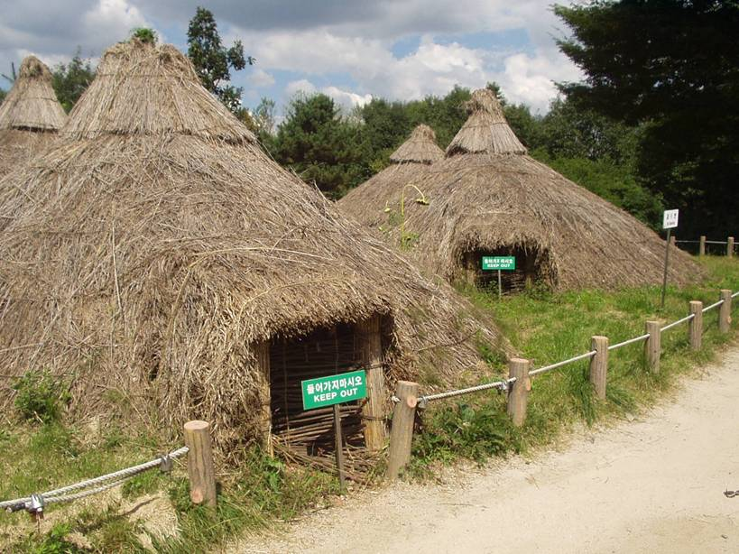
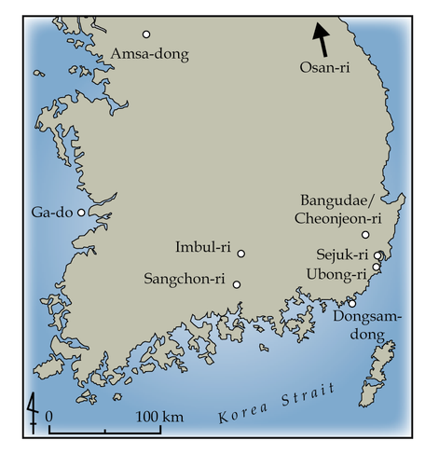
Korean Peninsula
Paleolithic period (ca. 50,000 BP – 8000 BCE)
  Proto-Koreans were migrants from south-central Siberia during the bronze age.
Neolithic life (ca. 8000 BCE to 1500 BCE)
Neolithic semi-subterranean pit dwellings
Neolithic sites in South Korea
Barnes, Gina Lee (1993). The Rise of Civilization in East Asia: The Archaeology of China, Korea and Japan. Thames and Hudson.

Slide 12
Five Thousand Years of Korean History
Country | Time
2333 B.C. | Go-Joseon
1st century B.C. | Three kingdoms (Shilla, Baekje and Goguryeo)
668 – 935 | Silla (south: 668-935) Balhae (north: 698-926)
935 - 1392 | Goryeo Dynasty
1392 – 1910 | Joseon Dynasty
1910 - 1945 | Japanese rule
1948 | Established Republic of Korea in South, Democratic Peoples Republic in the North
1950-1953 | Korean war
1961 | Military coup
1988 | Seoul Olympics
Notes:
The history of Korea dates back almost 5,000 years. The country started modernization and economic development in the late nineteenth century, a process blocked by Japanese colonial annexation in 1910. Rapid economic and industrial development began again in the 1960s.

Slide 13
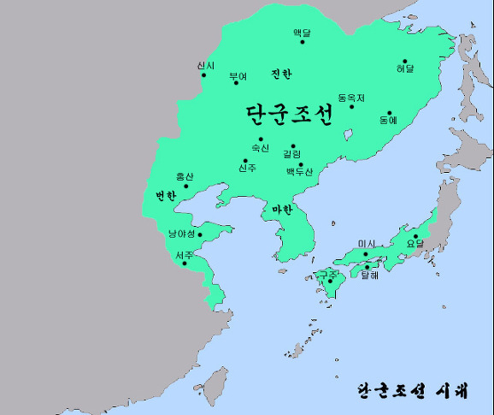
Go-Joseon
Country | Time
2333 B.C. | Go-Joseon
1st century B.C. | Three kingdoms (Shilla, Baekje and Goguryeo)
668 – 935 A.D. | Silla (south: 668-935) Balhae (north: 698-926)
935 - 1392 | Goryeo Dynasty
1392 – 1910 | Joseon Dynasty
1910 - 1945 | Japanese rule
1948 | Established Republic of Korea in South
1950-1953 | Korean war
1961 | Military coup
1998 | Seoul Olympic Game
King Dan-gun established Go-Joseon in 2333 B.C.
Notes:
According to Korean mythology King Dan-gun was the founding father of Go-Joseon; his father was the son of a deity and his mother, a woman transformed from a bear. The Story of Dan-gun from the 13th century Remnants of the Three Kingdoms explains that a tiger and a bear prayed to be transformed into humans. The deity instructed them to eat only garlic while avoiding sunlight by staying in a cave for 40 days. Tiger could not stand it and left the cave before 40 days. The bear stayed in the cave for 40 days and became a woman, Woong-nyeo (in Korean it means bear woman) and married Hwan-woong, son of the deity. Woong-nyeo may have been a princess of a tribe worshiping bear, Hwan-woong, perhaps a prince of a strong tribe.

Slide 14
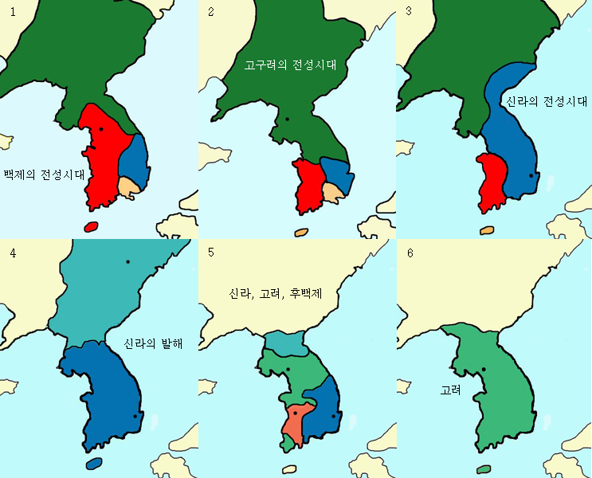
Three Kingdoms to Goryeo
Country | Time
10th century B.C. | Go-Joseon
1st century B.C. | Three kingdoms (Silla, Baekje and Goguryeo)
668 – 935 A.D. | Shilla (south: 668-935) Balhae (north: 698-926)
935 - 1392 | Goryeo Dynasty
Buddhism became national religion.
Arts and culture flourished during Silla Dynasty.
Balhae
Goguryeo
Silla
Goryeo
Baekje
Shilla
Notes:
Go-Joseon was divided into three kingdoms, Goguryeo, Baekje, and Silla. Silla unified the peninsula by forming an alliance with Chinese Tang dynasty and attacking Goguryeo simultaneously. Descendants of Goguryeo established Balhae in the northern territory. Unified Silla prospered with splendid artistic and cultural achievements for nearly 300 years. Gyeongju historic area , capital of the Silla kingdom (57 BC – 935 AD), is a superb showcase of the kingdom’s achievements in arts, science, architecture, and landscape design. The area was designated as UNESCO’s World Cultural Heritage in 2000.
Buddhism was introduced to Korea during the 4th century and later became a state religion from late three kingdoms to Goryeo dynasty. Most of the national treasures of South Korea are Buddhist artifacts.

Slide 15
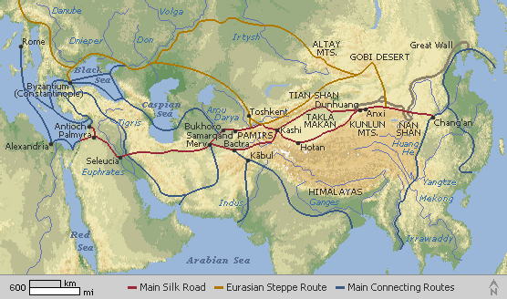
Silk Road reached Korean peninsula

Slide 16
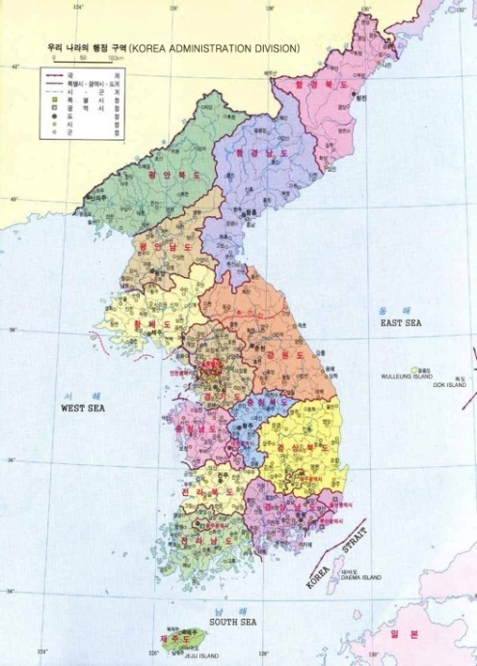
Joseon (1392-1910)
Country | Time
10th century B.C. | Go-Joseon
1st century B.C. | Three kingdoms (Silla, Baekje and Goguryeo)
668 – 935 A.D. | Silla (south: 668-935) Balhae (north: 698-926)
935 - 1392 | Goryeo Dynasty
1392 – 1910 | Joseon Dynasty
Expanded territory boundary up to Yalu river in north.
Confucianism was promoted by government.
Korean alphabet was invented.
Sijo became popular.
Notes:
Yi Sung-gye overthrew Goryeo dynasty and established Joseon. He expanded territory to Yalu river. Current boundary between China and North Korea, Yalu river and Doo-man river, was established at this time. The fourth king, Sejong (1418-1450) brought many innovations to government, most famously Hangul, the Korean phonetic alphabet.

Slide 17
Japanese Rule
Country | Time
10th centry B.C. | Go-Joseon
1st centry B.C. | Three kingdoms (Silla, Baekje and Goguryeo)
668 – 935 A.D. | Silla (south: 668-935) Balhae (north: 698-926)
935 - 1392 | Goryeo Dynasty
1392 – 1910 | Joseon Dynasty
1910 - 1945 | Japanese rule
Japan annexed Korea
by force in 1910.
Japan in 1938 outlawed
use of Korean language
in an attempt to eradicate
Korean national identity.
Deep lament and resentment toward invaders prevailed in Korean literature and music, along with attempts to grapple with new, modern forms.
Notes:
Japan modernized its army in late 19th century and built a strong military power. In early 20th century Japan invaded Korea and northern China. In its effort to eradicate Korean culture and identity, Japan in 1938 banned the use of the Korean language in schools, forced Koreans to abandon Korean names and change them to Japanese names. While many made such changes, however reluctantly, others, like the poet, Buddhist monk and resistance leader Han Yong-un (1879-1945). Korean resistance movement groups fought the Japanese in Korea and northern China. Koreans in Shanghai, the US and elsewhere in exile sought to gsin support to free Korea from Japanese rule, but in vain.

Slide 18
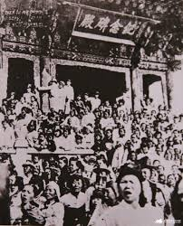
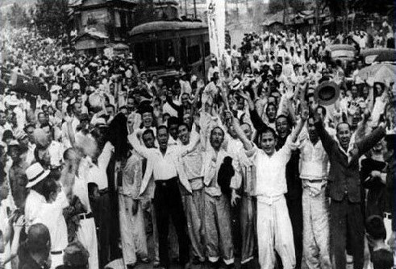
1919 March First Movement
Inspired by Wilson’s 1918 Versailles speech on self-determination of nations
Surprise event coinciding with King Kojong’s funeral
Declaration of Independence, peaceful march

Slide 19
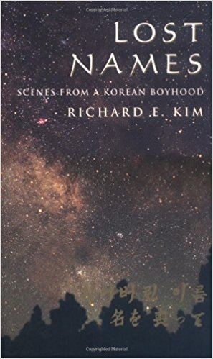
Assimilation Policies by Japanese Ruler
Japan in 1938 outlawed use of Korean language in an attempt to eradicate Korean national identity.
Koreans were forced to change names to Japanese names: both surnames and first names
Lost Names by Richard Kim: Japanese teacher tells Kim’s father, “I am sorry… Even the British wouldn’t have thought of doing this sort of primitive thing in India… inflicting on you this humiliation…unthinkable for one Asian people to another Asian people, especially we Asians who should have a greater respect for our ancestors.” (p 109)

Slide 20
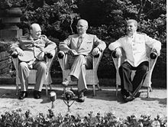
Divided Peninsula
Country | Time
10th century B.C. | Go-Joseon
1st century B.C. | Three kingdoms (Shilla, Baekje and Goguryeo)
668 – 935 A.D. | Silla (south: 668-935) Balhae (north: 698-926)
935 - 1392 | Goryeo Dynasty
1392 – 1910 | Joseon Dynasty
1910 - 1945 | Japanese rule
1948 | Established Republic of Korea in South
1950-1953 | Korean war
1961 | Military coup
1988 | Seoul Olympics
In 1945 at Postdam conference US (Truman), USSR (Stalin) and UK (Churchil) decided to divide Korean peninsula at 38th parallel without consulting Koreans.
Notes:
Surrender of Japan to the Allied Forces in August 1945 ended the Japanese occupation of Korea. Korean peninsula was divided at 38th parallel by Allied Forces (US, USSR and UK). Two competing provisional governments were formed: Republic of Korea (ROK, South Korea, also known as, Korea) in the south, backed by US, while the Democratic Peoples Republic Korea (DPRK, also known as North Korea) was established in the north under the supervision of the USSR with support also from communist China.

Slide 21
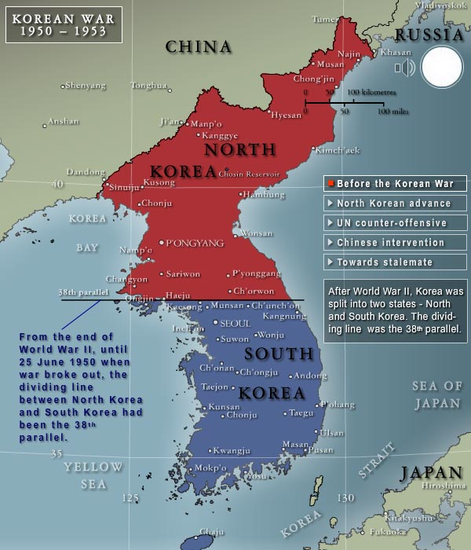

Slide 22
Korean War (1950 – 1953)
Country | Time
10th century B.C. | Go-Joseon
1st century B.C. | Three kingdoms (Shilla, Baekje and Goguryeo)
668 – 935 A.D. | Shilla (south: 668-935) Balhae (north: 698-926)
935 - 1392 | Goryeo Dynasty
1392 – 1910 | Joseon Dynasty
1910 - 1945 | Japanese rule
1948 | Established Republic of Korea in South
1950-1953 | Korean war
1961 | Military coup
1988 | Seoul Olympics
North Korea invaded south by launching surprise attack on 6/25/50.
United Nations forces led by US defended South.
Armistice agreement was signed by UN, North Korea, and China in 1953.
Many Koreans lost or separated from family members in both south and north.
Notes:
Armistice agreement was signed by UN, North Korea, and China in 1953 dividing Korea North and South at the 38th parallel. This was one of the bloodiest wars in human history. Total estimated military casualties were about 1.5 million (including 37,000 US soldiers); civilian casualties were about 2.5 million. Korean literature and music at this time reflect feelings of deep sorrow and hopelessness.

Slide 23
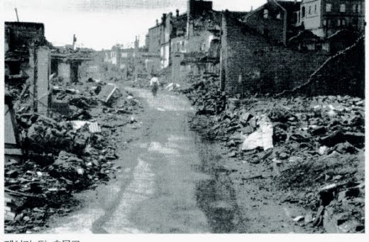
Korean War (June 25, 1950 – July 27, 1953)
Not a simple civil war.
“Proxy War”: two superpowers (US & Soviet Union) fought a “limited war” in a third country.
China emerged as a significant military power.
This is the first war in which the UN participated.
Support base was in Japan, which helped rapid industrial expansion and economic growth of Japan.
http://www.history.army.mil/reference/Korea/kw-remem.htm
http://korean-war.commemoration.gov.au/cold-war-crisis-in-korea/
https://www.britannica.com/event/Korean-War
https://www.quora.com/What-was-the-significance-of-the-Korean-War
Notes:
"The aftermath of the Korean War set the tone for Cold War tension between the superpowers. The Korean War was important in the development of the Cold War, as it showed that the two superpowers, United States and Soviet Union, could fight a "limited war" in a third country. The "limited war" or "proxy war" strategy was a feature of conflicts such as the Vietnam War and the Soviet War in Afghanistan, as well as Angola, Greece, and wars in the Middle East.“
“It will take 100 years for South Korea to recover from the war.” - Gen. McArthur
The fact that the Chinese openly, and the Russians covertly, fought on the side of the North Koreans also furthered the idea that this was a struggle not against a single nation but against an ideological threat. The Communists were a single bloc to be faced again and again around the world. (This was not, in fact, the case as the Soviets and Chinese very quickly had a falling out, as did the Chinese and the Vietnamese).
Korea also influenced the US's view of the United Nations. For the first two years of the war, the UN was a formidable fighting force that actually pushed the North Koreans off the pennisula before China intervened on their behalf. But the final year of the war was spent trading shots and grabbing small parcels of land while the UN attempted to negotiate a peace deal. In the future (such as Vietnam and beyond), the US would not seek the UN as an ally as it often incurred too many "handcuffs." (The fact that the Soviets also would not make the same mistake of not being present for a vote on UN wars would also prevent this alliance from happening.)
Finally, had the Korean War not occurred, South Korea would not be one of the 10 fastest growing economies in the world or one of the most technologically advanced nations today. At the time of the war, South Korea was a third world, agrarian economy with no real prospects for development. There was no reason for the US or other nations to invest in it. The North Koreans were a industrial powerhouse that had the potential to dominate the manufacturing world. After the war, the US rebuilt South Korea and remained a dedicated partner in every fashion. Helping the South Koreans to surpass the US in terms of technology and economic growth.

Slide 24
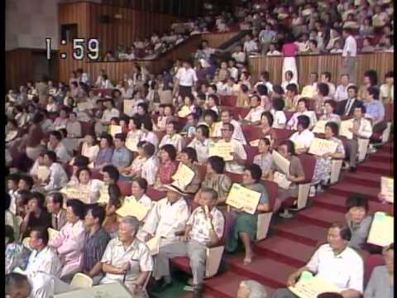
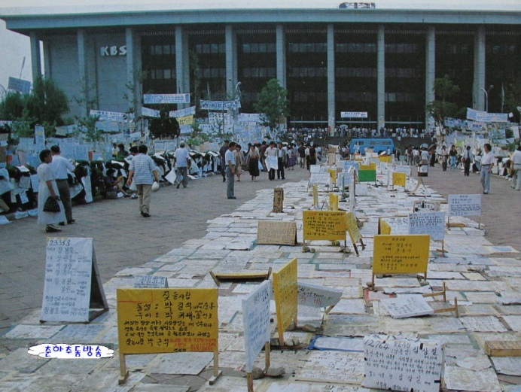
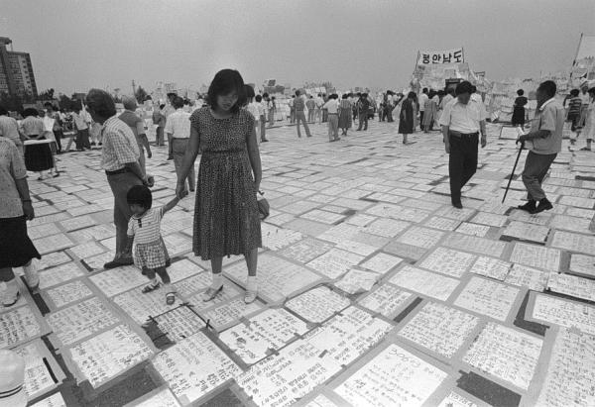
KBS TV Live: Looking for Dispersed Family
Started as one-day special program on 6/30/1983
Continued non-stop until 11/14/1983 (453 h 24 m)
53,536 families appeared
10,189 families found lost ones
Notes:
The pain of dispersed family is obvious even after 30 years after the ceasfire. The KBS (Korean Broadcasting Service) planned a live TV program in 1983 for one evening. Due to overwhelming response, they had to continue for 453 hours and 24 minutes. People looking for lost families kept coming to the KBS studio, set up tents while waiting to get inside the studio. The entire nation felt the deep pain and sorrow of these families and cried with them.

Slide 25
Modern Korea
Country | Time
10th century B.C. | Go-Joseon
1st century B.C. | Three kingdoms (Shilla, Baekje and Goguryeo)
668 – 935 A.D. | Shilla (south: 668-935) Balhae (north: 698-926)
935 - 1392 | Goryeo Dynasty
1392 – 1910 | Joseon Dynasty
1910 - 1945 | Japanese rule
1948 | Established Republic of Korea in South
1950-1953 | Korean war
1961 | Military coup
1988 | Seoul Olympics
Economic development plan began after military coup in 1961
Technologically advanced
2017 Korean GDP ranked No. 11 in the world.
Democracy established since 1998
Notes:
Korea (South Korea) is a developed country and it has one of the world's fastest growing economies from the early 1960s to the late 1990s. Korean GDP ranked No. 12 in the world. Koreans call this rapid transformation the “Miracle on the Han River.” The growth surge was achieved by concentrating on labor-intensive manufactured exports. As of 2009, South Korea is the world's eighth largest exporter.

Slide 26
Major inventions by Koreans

Slide 27
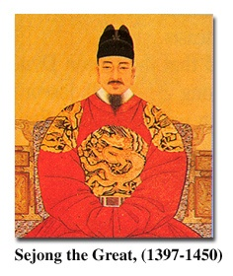
Korean Alphabet: Hangul (한글)
King Sejong the Great invented Korean alphabet in 1443.
Alphabet organizes written language into syllabic units.
14 consonants & 10 vowels
Hangul is a scientific system, invented following the shapes of vocal organs as they make sounds.
"A wise man can acquaint himself with them before the morning is over; a stupid man can learn them in the space of ten days”.
From http://library.thinkquest.org/20746/non/info/index.html
Notes:
Hangul is the only alphabet in the whole world invented by one person. It is a purely phonetic alphabet with 10 vowels and 14 constants.
Koreans used Chinese characters before the invention of Korean alphabet. The majority of Koreans were effectively illiterate before the invention of Hangul.
In explaining the need for the new script, King Sejong explained that the Korean language was different from Chinese; using Chinese characters to write was so difficult for the common people that only privileged aristocrats, usually male, could read and write. Hangul was designed so that even a commoner could learn to read and write.
"Hunmin Jeong-eum Explanation and Examples“ explains the design of the consonant letters according to “articulatory phonetics” and the vowel letters according to the principles of “yin and yang” and “vowel harmony”.
From http://library.thinkquest.org/20746/non/info/index.html

Slide 28
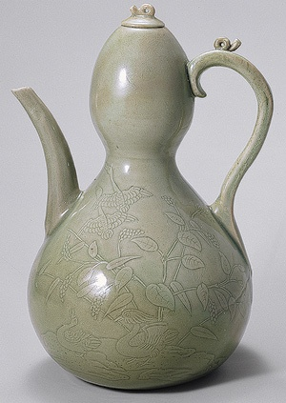
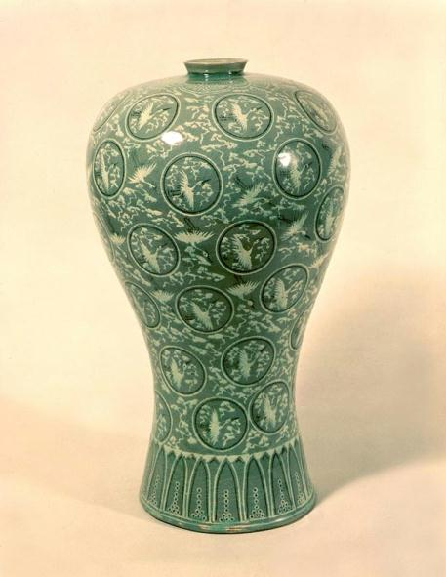
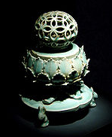

Korean Ceramics
Celadon with pale jade green glaze and inlaid pattern was invented in 10th century during Koryo dynasty.
Inlay technique was invented which produce optical effect of image floating above the surface of the pots
Notes:
Elegant jade-green celadon became a signature pottery of Goreyo dynasty perfecting the technique in mid 12th century. The inlaying technique of incising patterns on the surface of the vessel was an unique invention of Goreyo craftsman. In the entire world at the time, only China and Korea possessed the technology necessary to produce the celadon ceramic ware.
An innovative Korean contribution to world ceramics was the use of black and white inlays placed beneath the glaze to depict images such as clouds, cranes, and flower, often accompanied by a crackle pattern. Observation yields an optical effect of the image floating above the surface of the pot due to the increased reflection and local brightening from the internal surfaces of the cracks. Poets and others have described flights and floating images during banquets.

Slide 29
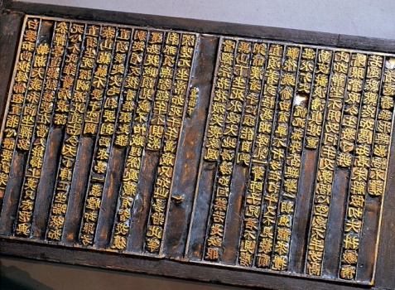
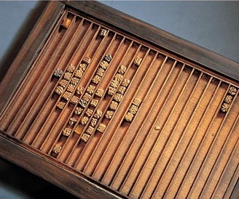
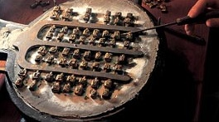
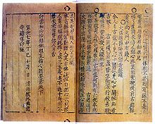
UNESCO’s Memory of the World:
Movable Metal Type for Printing
Invented in 13th century (before 1232) during Goryeo dynasty
The world oldest extant movable metal print book is the Jikji (Korean Buddhist document), printed in Korea in 1377.
78 years prior to Gutenburg’s metal type printing
Notes:
Baegun hwasang chorok buljo jikji simche yojeol (Jikji) contains the essentials of Zen Buddhism compiled by priest Baegun in late Goryeo period. The book was printed in two volumes. The first volume is still missing and the second volume is kept in the Bibliothèque Nationale of France.
UNESCO Memory of the World (http://portal.unesco.org/ci/en/ev.php-URL_ID=22953&URL_DO=DO_TOPIC&URL_SECTION=201.html)

Slide 30
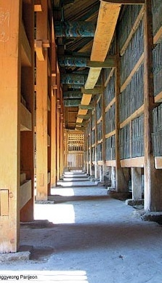
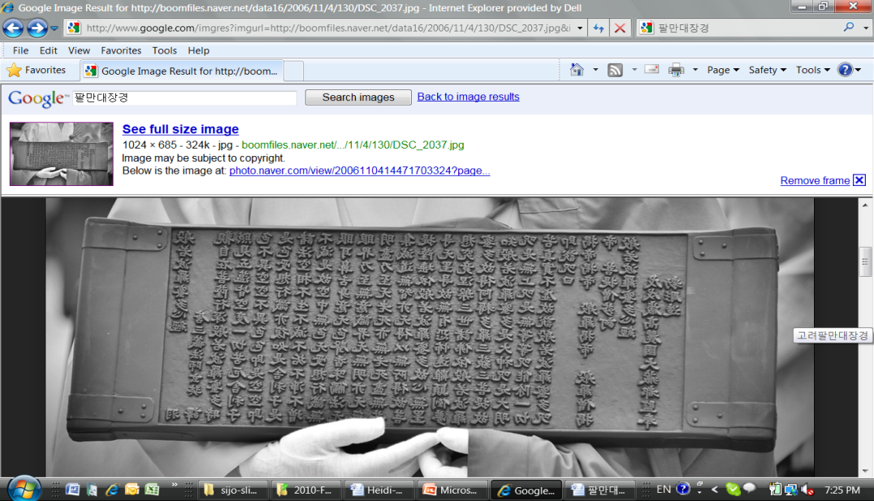
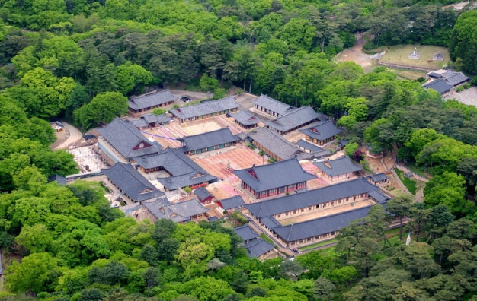
UNESCO’s Memory of the World:
Printing Woodblocks of the Tripitaka Koreana
Woodblocks for printing Tripitaka (Buddhist scriptures)
81,258 pieces of woodblocks
Took 16 years to complete the project (1236-1251)
Woodblocks were treated by a special process for long-term preservation
Notes:
The Temple of Haeinsa, on Mount Kaya, is home to the Tripitaka Koreana, the most complete collection of Buddhist texts, engraved on 80,000 woodblocks between 1237 and 1248. The buildings of Janggyeong Pangeon, which date from the 15th century, were constructed to house the woodblocks, which are also revered as exceptional works of art. As the oldest depository of the Tripitaka, they reveal an astonishing mastery of the invention and implementation of the conservation techniques used to preserve these woodblocks. This project was an expression of pious devotion of king and its people to Buddha.
-Left: woodblock
-Center: aerial view of Hae-in-sa Temple
-Right: inside of depositories
UNESCO World Heritage (http://whc.unesco.org/en/list/737)

Slide 31
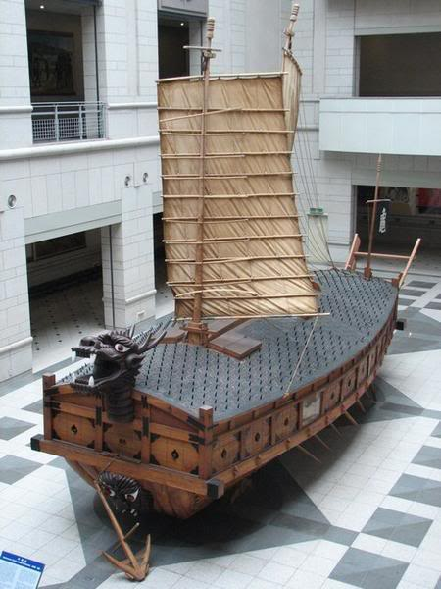
Ingenious Inventions:
Geobukseon (Turtle –Shaped Warship)
The world first ironclad warship, Geobukseon (Turtle-shaped Warship), was built by General Yi Sun-shin in 1592 during the Japanese invasion.
The ships had armored and spiked decks and cannons and were designed to be highly maneuverable .
Notes:
Recognized as a breakthrough in military technology, Geobukseon replicas are on exhibit in a number of national museums, including the War Memorial of Korea, the War Memorial Museum in the U.S., the National Maritime Museum in England and historical museums in China, Germany and other countries.

Slide 32
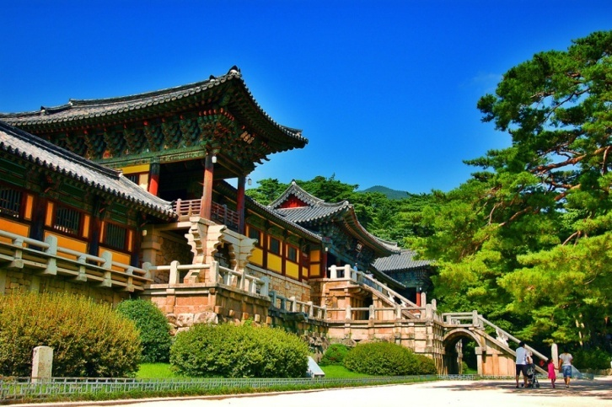
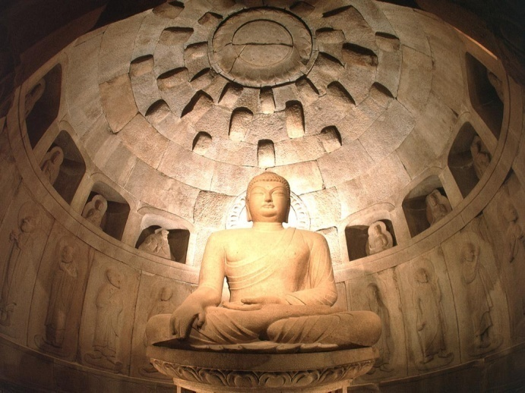
UNESCO’s Memory of the World:
Bulguksa and Seok-gu-ram
Bulguksa,
  Constructed in 751 AD during Shilla kingdom
  Main temple, gates, stone pagodas, bridges are all architectural masterpieces
Seokguram Grotto
  Granite sanctuary for stone Buddha
  Wearing a serene smile of benevolence
Notes:
Established in the 8th century on the slopes of Mount T'oham, the Seokguram Grotto contains a monumental statue of the Buddha looking at the sea in the bhumisparsha mudra position. With the surrounding portrayals of gods, Bodhisattvas and disciples, all realistically and delicately sculpted in high and low relief, it is considered a masterpiece of Buddhist art in the Far East. The Temple of Bulguksa (built in 774) and the Seokguram Grotto form a religious architectural complex of exceptional significance.
UNESCO World Heritage (http://whc.unesco.org/en/list/736)

Slide 33
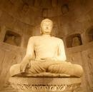
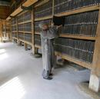
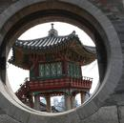
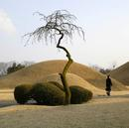
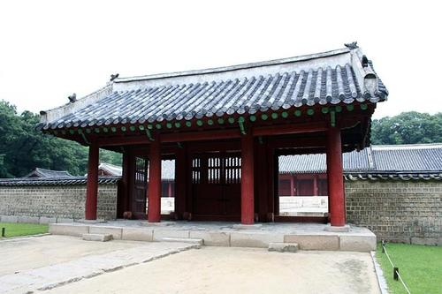
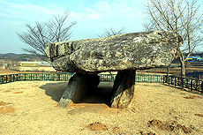
UNESCO’s World Cultural Heritages
Seokguram Grotto and Bulguksa Temple
Tripitaka Koreana Woodblocks Depository
Changdeok-gung Palace
Gyeongju Historic Areas
Dolmen Sites in Ganghwa, Hwasun, & Gochang
Jongmyo Shrine of Joseon Royal Ancestors
Notes:
Six historic sites in Korea have been accepted in the UNESCO’s World Cultural Heritage listing.
To be included on the World Heritage List, sites must possess outstanding universal value and meet at least one out of ten selection criteria.
Selection criteria:
1. to represent a masterpiece of human creative genius;
2. to exhibit an important interchange of human values, over a span of time or within a cultural area of the world, on developments in architecture or technology, monumental arts, town-planning or landscape design;
3. to bear a unique or at least exceptional testimony to a cultural tradition or 4. to a civilization which is living or which has disappeared;
5. to be an outstanding example of a type of building, architectural or technological ensemble or landscape which illustrates (a) significant stage(s) in human history;
6. to be an outstanding example of a traditional human settlement, land-use, or sea-use which is representative of a culture (or cultures), or human interaction with the environment especially when it has become vulnerable under the impact of irreversible change;
7. to be directly or tangibly associated with events or living traditions, with ideas, or with beliefs, with artistic and literary works of outstanding universal significance. (The Committee considers that this criterion should preferably be used in conjunction with other criteria);
8. to contain superlative natural phenomena or areas of exceptional natural beauty and aesthetic importance;
9. to be outstanding examples representing major stages of earth's history, including the record of life, significant on-going geological processes in the development of landforms, or significant geomorphic or physiographic features;
10. to be outstanding examples representing significant on-going ecological and biological processes in the evolution and development of terrestrial, fresh water, coastal and marine ecosystems and communities of plants and animals;
11. to contain the most important and significant natural habitats for in-situ conservation of biological diversity, including those containing threatened species of outstanding universal value from the point of view of science or conservation.
The protection, management, authenticity and integrity of properties are also important considerations.

Slide 34
Religions of Korea

Slide 35
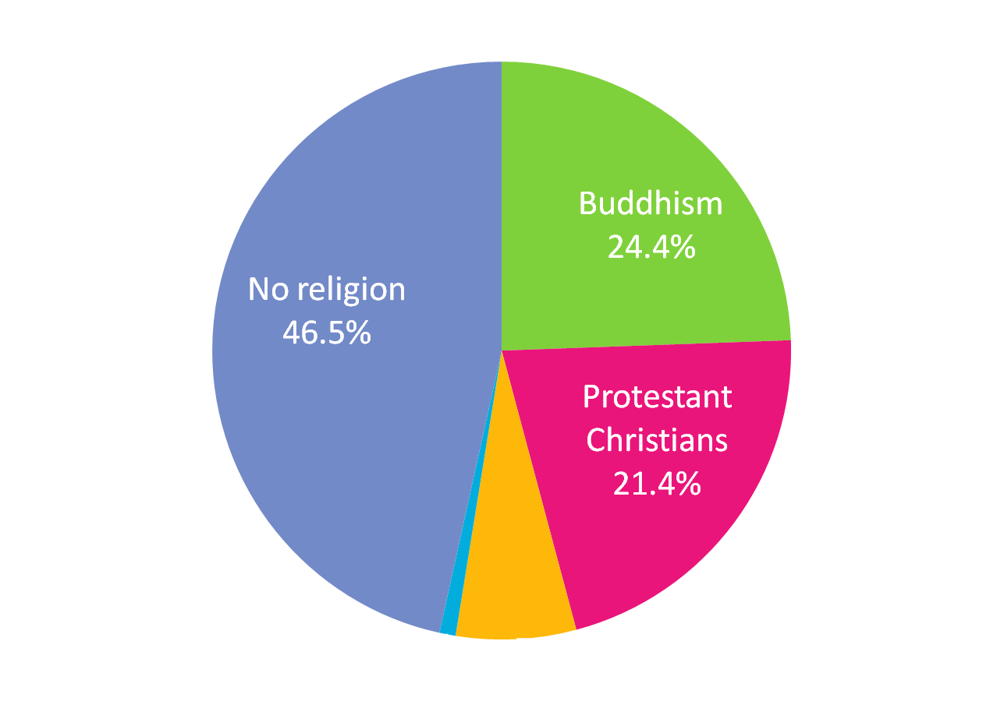
Religions of Korean People
(2014 Gallup Report)
Notes:
Korea is one of few countries where Buddhism and Christianity coexist with almost equal strength.
Worldwide distribution of religion: Christianity (catholics + protestants + others) 33%, Buddhism 6%, Islam 21%, Hinduism 14%, no religion 16% (in 2005 from www.adherents.com)

Slide 36
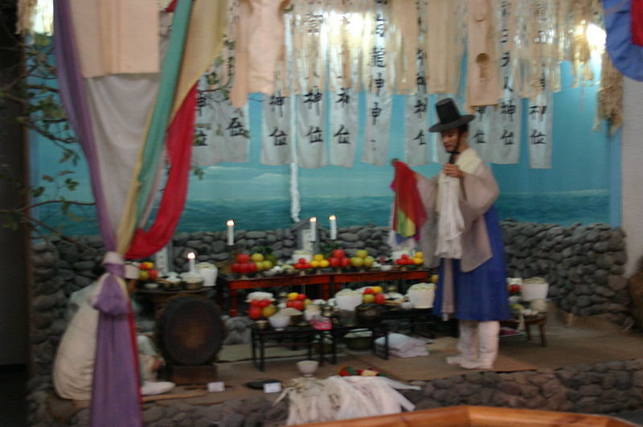
Korean Shamanism
Shamanism has deep roots in folk beliefs.
Related to the ancient communal worship rites offered to the gods of heaven.
Participants seek to resolve human problems through a meeting of humans and the spirits mediated by the shaman
Shaman is about to perform a ritual. The shaman wears a colorful costume, speaks in a trance as a spiritual oracle, and sings and dances to music.
Notes:
Three elements are seen as essential to a “goot” (Korean shamanistic ritual): the spirits as the object of folk beliefs, the believers praying to those spirits, and the shaman mediating between the spirits and the believers.

Slide 37
Korean Buddhism
Introduced to Korea druing three kingdom era (around 372 A.D.)
Became state religion in three kingdoms and Koryo dynasty
Deep influence in every aspect of Korean life, culture, and arts
Currently about 24% of population is Buddhist.
Buddha’s birthday is national holiday in Korea.
Notes:
Buddhism is a philosophy and religion, brought to Korea almost 1800 years ago. The principles of Buddhist teaching are deeply rooted in the way of life among Koreans regardless of their religion.
Many national treasures in art and architecture are Buddhism related, such as, Buddhist temple buildings or statues of Buddha.

Slide 38
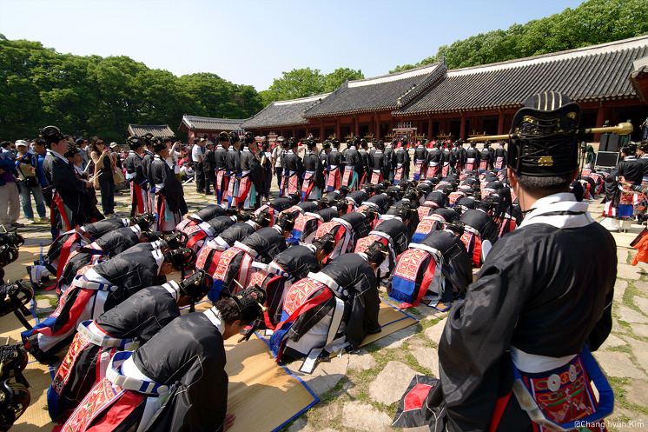
Korean Confucianism
Joseon dynasty promoted Confucian philosophies as national philosophy
Complex system, selectively imported from China, of moral, social, political, philosophical, and quasi-religious thought.
Became an indispensable component of the Korean moral system, way of life, and laws
Memorial rite to the kings of the Joseon Dynasty is performed at Jong-myo Shrine
Notes:
Joseon dynasty adopted Confucianism as its ruling ideology. Important Korean Confucian ceremonies are “coming of age at age 15 years”, marriage, death, and the anniversary of an ancestor’s death. Among these, funerals had the greatest effect on people’s lives. The funeral was a way of expressing one’s innermost feelings, and its conduct and atmosphere depended on the degree of intimacy or formality in the relationship between the living and the deceased. The Joseon promoted a revised form of Confucianism,calld Neo-Confucianism, that had also been developed in China. In the 18th and 19th centuries, scholars developed and promoted the emergence of Silhak, or Practical Learning, which some see as an early step toward modern social and scientific practices.

Slide 39
Korean Christianity
Catholicism was imported into Korea by a Korean scholar, Yi Seung-hun, who was baptized while visiting China.
  Thousands of Catholics were executed during government persecution in the late Joseon dynasty.
  103 martyrs were canonized in 1984.
Protestant missionaries came to Korea during Japanese rule in the early 20th century.
  Dedicated to higher education and health care
Catholics and Protestant Christians are more populous in urban areas and often have higher education levels.
Notes:
Korea is the only country where Catholicism was brought in by a native missionary, Kim Dae-Gun, who went to a seminary in Macao. Rev. Kim returned to Korea as an ordained priest and was executed during persecution along with thousands of other fellow Catholics. The monument for martyrs is at the site of execution, Jul-Doo-San (meaning “mountain of beheading”).
Protestant evangelists came to Korean during the Japanese colonial occupation. They operated high schools, colleges, and hospitals and gained strong influence among better educated young people.
Currently, Korean missionaries, the world’s second largest group after Americans, are working in more than 150 countries.

Slide 40
Korean arts, food, dress,& music

Slide 41
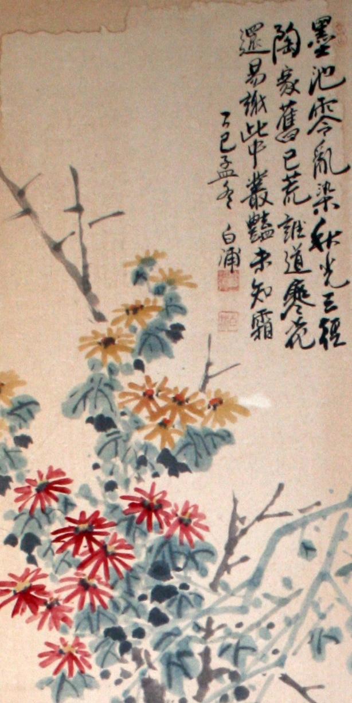


Traditional Arts: Painting
Typically use few color, leaving background blank
Often combined with poem.
Painters signed their artistic name and signature stamps
Typically use few color, leaving background blank.
Often combined with poem.
Painters signed their artistic name and signature stamps.
Notes:
Most paintings’ background is left blank, allowing space for the viewer’s imagination. Signature of painter and seal in red ink are part of the painting. Often painters use multiple seals and seal engraving is an art itself. Calligraphy is an important part of the Korean painting.

Slide 42




Korean Dance and Music
Court dance and music
Folk dance and music
Notes:
Click the title “Korean Dance and Music” to watch collage of Korean Dance.
Please click the pictures to watch video clips of Korean dance performances.
Court dancers often accompanied by an ensemble of Korean instruments. Some are slow and elegant (upper left), while others may start slow but tempo accelerates toward ending.
Upper right is Korean fan dance.
Folk dance and music are frequently played by farmers, after harvest or at the field to cheer up the famers at work. Percussion instruments are important parts of folk music. Farmers dance (bottom left) shows performers wearing hats with long tapes spinning. The performers spin the tapes by rotating their heads while playing small hand-drums and gongs. Gang-gang-suwol-rae (bottom right) was performed by young women under the bright full-moon festival at the first harvest known as Chu-seok (equivalent to Thanksgiving day in US). Click this picture and watch “Three-drum dance”.

Slide 43




Korean Dress
Notes:
Upper middle: children’s dress
Right: elegant Korean dress for upper class woman
Bottom right: young boy of upper class
Bottom middle: commoner man and woman
Left: dress of the Queen

Slide 44


Korean Food
Cooked rice, main dish, and side dishes
  3-12 side dishes
Kimchi
  fermented pickled vegetable with or without hot pepper, hundreds of variations
Common elements of cooking
  soy sauce
  soy-bean paste (dyon-jang similar to miso)
  hot-pepper paste (go-chu-jang)
  sesame oil
  Lots of vegetables
Notes:
More side dishes were served for more affluent people, while less were served for poor people.
Kimchi is fermented vegetables. Typical kimchi is made of Korean cabbage with hot pepper. Numerous variations of kimchi exist such as kimchi made with cucumber, radish, turnip, or green onions. Some kimchi is prepared without hot-pepper.
Pictures on left shows many side dishes; picture on right is Bi-bim-bap, rice with several vegetable and beef toppings served with hot-pepper paste and sesame oil.

